Slide 1
Cell-Based Brain-Machine Interface
Neuralink, US 2023/0077899 A1, Published 3/16/2023
6/23/2024

Slide 2
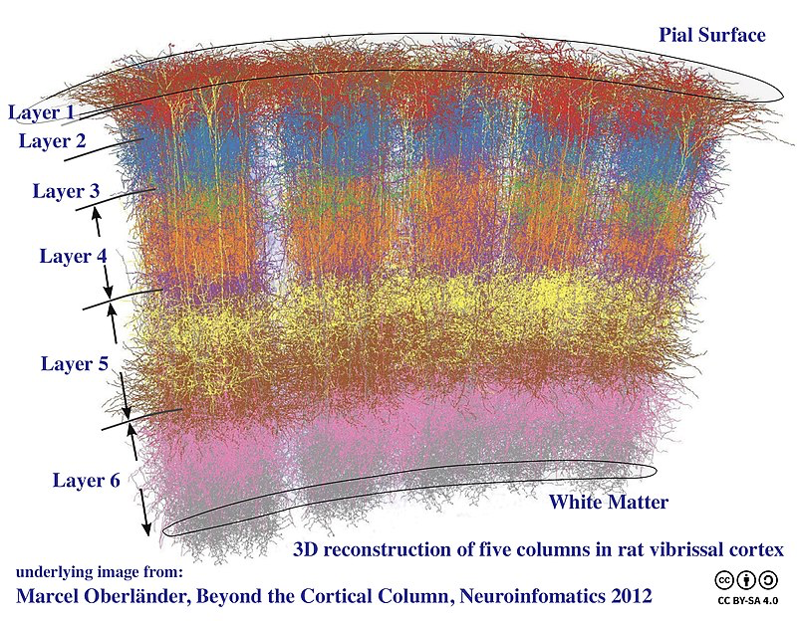
Background
Scaling BMIs enables neurological therapies & better information transfer
Non-invasive BMIs – low resolution, unsuitable for high-bandwidth
ECoG – better signal quality, but mixed neuron signals
Penetrating BMIs – high bit rates, precise action potentials, limited scalability due to tissue displacement
Traditional electrode arrays – prone to tissue damage & infection
Biological approaches (e.g., neurotrophic growth, protein coatings, progenitor cells) shown promise in improve longevity
Calcium imaging – requires viral infection
Need new BMIs with living neuronal cells for better biocompatibility

Slide 3
Outline
Goal: Propose a novel way of connecting brains to computers by transplanting genetically modified cells (cell engraftment) onto brain surface
Embodiments:
Cell Engraftment + Definitions
4 BMI approaches: Optical, ECoG + Pour-Over Cells, Tethered Cells, ECoG Embedded Cells in Polymer
Preparation of BCI on Mice
Microscopic Imaging of Neuron Growth & Activity
Calcium Imaging
BMI Morpholog
BCI Integration, Function, and Sensitivity
Histological Analysis of BCI
Glial Response to BCI
Human Stem Cell-Derived Neurons
Cell-Tethering: Impact of In-Vitro Model on Neural Health

Slide 4
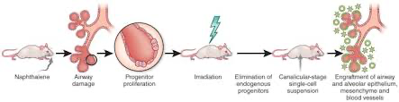
Cell Engraftment
Transplanted stem cells travel through bloodstream, into bone marrow
New blood cells get created
Usually occurs 2-6 weeks after stem cell implant (sometimes longer)
Signalizes beginning of recovery process – new cells are working properly, starting to rebuild immune system

Slide 5
Definitions
Brain-machine interface (BMI) – layer of neuronal cells engrafted onto & integrates into surface or layer of the mammalian brain
Cerebral cortex – outermost layer of neural tissue of cerebrum
Tethered cell – attached or joined neuronal cell
Cortical graft layer – layer of cells deposited or poured over cerebral cortex of a mammal
Electrocorticography (ECoG) – recording electrical activity in brain by placing electrodes in direct contact with cerebral cortex or surface of brain
Electrocorticogram (ECoG) – tracing of brain wave made by ECoG apparatus for detecting and recording brain waves with electrodes in direct contact with brain
External stimulus – outside change to external environment detected by mammal (e.g., changes to light, electrical impulse, sound, temperature, etc.)
Hydrogel – a water-insoluble, optionally cross-linked, 3D network of polymer chains with voids between polymer chains filled with or capable of being filled with water
Exogenous –originating from outside the organism
L1 – first layer of cerebral cortex or sheet of neural tissue outermost to cerebrum
L0 – a layer of exogenous cells placed or poured over cerebral cortex (e.g., transfected cell with exogenous functionalities)
Transfection – taking up of exogenous nucleic acid (expression vector) by host cell whether or not any coding sequences are expressed

Slide 6
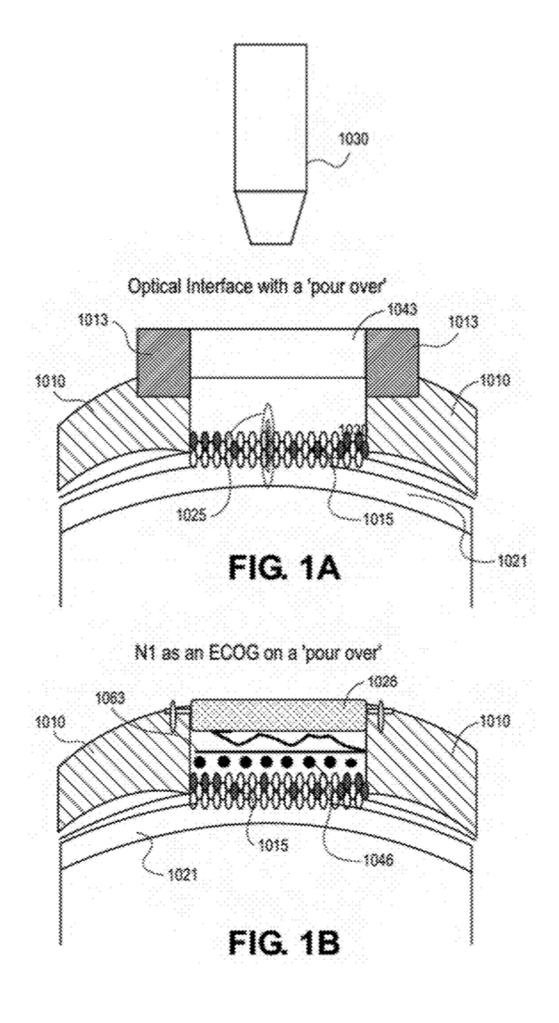

BMI using Optical Approach
- Imaging Device Usage: Multi-photon microscope/Miniscope used to observe neural activity in vivo through a clear cranial window
- Genetically Modified Cells: Deposited as genetically encoded calcium indicators (GECIs) on mammal cortex, excited to detect fluorescent changes, enabling high-speed, single-cell resolution recording.
- Fluorescent Imaging: Techniques include confocal and 2-photon calcium imaging, capturing signals from specific wavelengths
- Neuron Activity Tracking: Monitors neuron activity over time, showing integration and spontaneous activity changes post-transplantation.
- Bidirectional Communication: Cortical graft forms synaptic connections for communication between brain and external device.
- BCI Task: Mice modulate neural cursor for rewards, demonstrating control over neuron activity for BCI tasks.
Imaging device
(e.g., multi-photon microscope, Miniscope)
Clear cranial window (fixed)
Cranium
Excite & detect fluorescent changes/responses
Genetically modified cells in L0
Top of Cortex
Notes:
- Obtain fluorescent images using a confocal microscope
- Excite fluorophores using laser lines (e.g., 405, 48, 561 and 639 nm), with corresponding emission bandpass filters (e.g., of 420- 480 nm, 495-550 nm, 573-615 nm and 607-750 nm)
- Collect and process widefield images
Example GECI: pCAG-GCaMP7s-P2A-H2B-mRuby343
Interrogate (transmit signal to) L0
Assess whether it survives, integrates, or exhibits spontaneous activity
Assess cell counting and visualization of neural activity
Strong H2B-mRuby3 visible in mammal (thin band of cells on cortical surface)
Thickness of L0 doubled over first 2 weeks of engraftment before stabilizing, maintaining thickness

Slide 7
BMI using ECoG and Pour-Over Cells
- Electrical Approach: Used for BMI tasks in mammals, eliminating the need for fluorescently labeled cells and optical cranial windows
- ECoG Array: Placed flat on the cortex, spinal cord, or cranial nerve over the cell layer.
- Direct Link: Establishes a direct connection for information transmission between the brain cortex and the external ECoG array
- Measurement: ECoG measures cortical field potentials using electrodes on the cortex surface
- Connection: Threads connect the ECoG array to the electrodes
Threads
ECoG
Cranium
Deposited cell layer (L0)
Electrodes
Top of Cortex

Slide 8
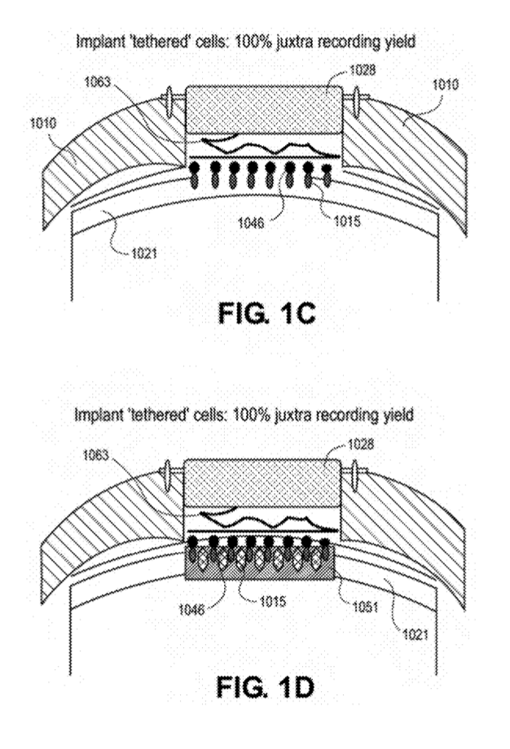
BMI using Tethered Cells
- ECoG Implantation: Implanted via craniotomy into the skull.
- Tethered Neuronal Cells: Cells are tethered to ECoG electrodes before implantation
- Placement: ECoG array placed flat on top of the cortex
- Juxtacellular Recording: Achieves 100% juxtacellular recording yield (perfectly aligned or positioned according to desired parameters)
ECoG
Threads
Cranium
Electrodes
Deposited cell layer (L0)
Top of Cortex

Slide 9
BMI using ECoG Embedded Cells in Polymer
- ECoG Device: Cells tethered to ECoG device.
- Hydrogel Packaging: Cells cultured and deposited in hydrogel before surgery, contains solid substrate onto cross-linked package (e.g., hyaluronic acid-based hydrogel; conductor)
- Implantation: Hydrogel with cells inserted into the cortex
- Connection: Threads connect ECoG to electrodes and hydrogel
- Formation and Function: Optimal cell placement with vascular channels, optional drug embedding to prevent issues
- Recording Yield: Ensures 100% juxtacellular recording yield
Threads
ECoG
Electrodes
Deposited cell layer (L0)
Hydrogel package
Top of Cortex

Slide 10
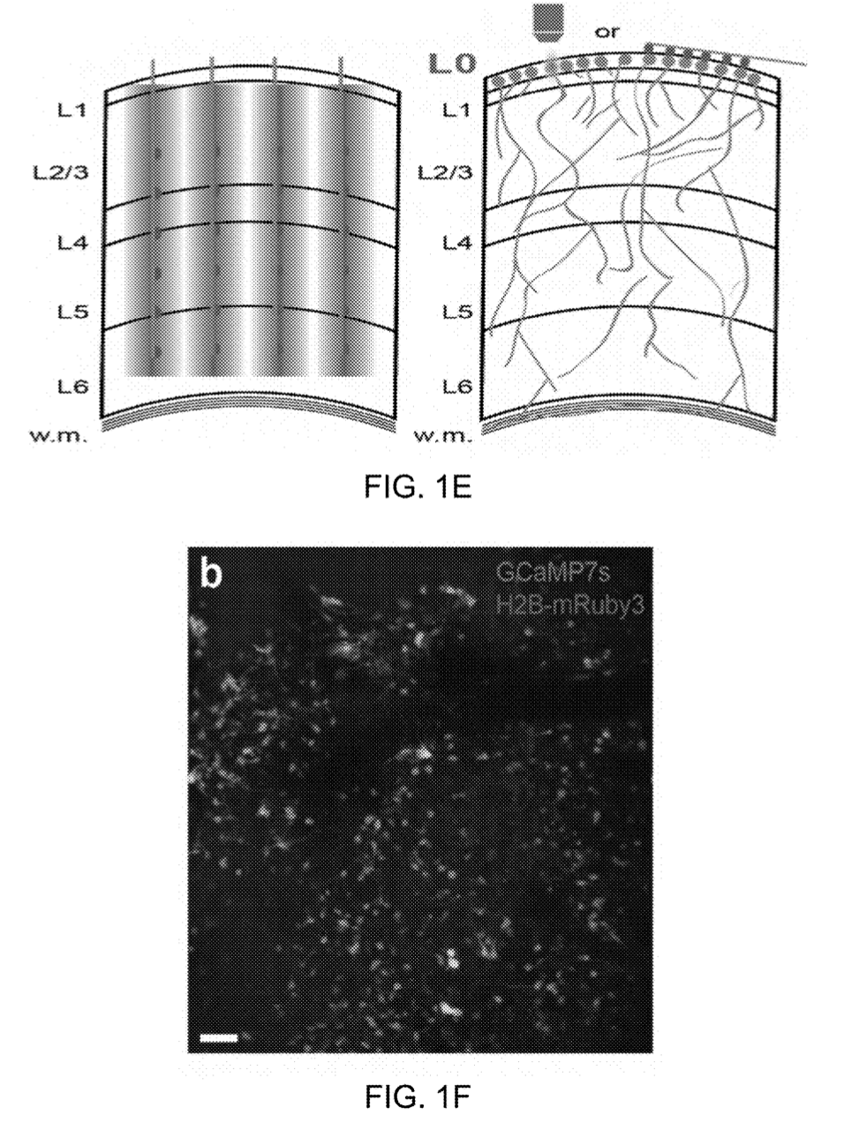

Preparation of BCI on Mice
1. Objective: Test the usefulness of a biological brain-computer interface (BCI) by training mice with transplanted neurons
2. Experimental Preparation:
- Developed an artificial cortical layer (L0) above layer 1 (L1) using techniques for neural cell culture and cranial windows
- Isolated mouse primary cortical neurons (E14-17), electroporated with plasmid DNA, and deposited them onto the cortical surface of adult mice
3. Methodology:
- Applied a glass coverslip for optical access and monitoring neuron development
- Evaluated electroporation efficiency with red fluorescent protein DNA, estimating transfection efficiency at ~1%
4. Controls:
- Non-electroporated plasmid DNA was digested to prevent off-target expression and ensure accurate recording from only engrafted cells
Penetrating electrodes – damage to cortex
Alternative scheme – transplant artificial cortical L0 for easy accessibility to recording devices + non-traumatic penetration

Slide 11



Microscopic Imaging of Neuron Growth and Activity
1. Objective: Assess the survival, integration, and activity of transplanted neurons
2. Method:
- Transplanted neurons electroporated with pCAG-GCaMP7s-P2A-H2B-mRuby3 for visualization and counting
- Imaged awake, head-fixed mice on a treadmill using a 2P microscope
3. Results:
- Strong H2B-mRuby3 signal observed ~2 days post-transplantation, identifying a thin band of cells on the cortical surface
- Thickness of the transplanted layer (L0) doubled in the first two weeks and stabilized thereafter (day 3: 94±20 μm, day 18: 194±14 μm, p=0.001).
4. Cell Death and Growth:
- No significant cell death observed; a trend for increased labeled neurons was noted
- Possible explanations for the increase - constitutively active promoter or the emergence of weakly expressing neurons from the noise floor Progenitor cell division post-engraftment cannot be ruled out
Example 2P Image of L0 3 Days after Engraftment

Slide 12
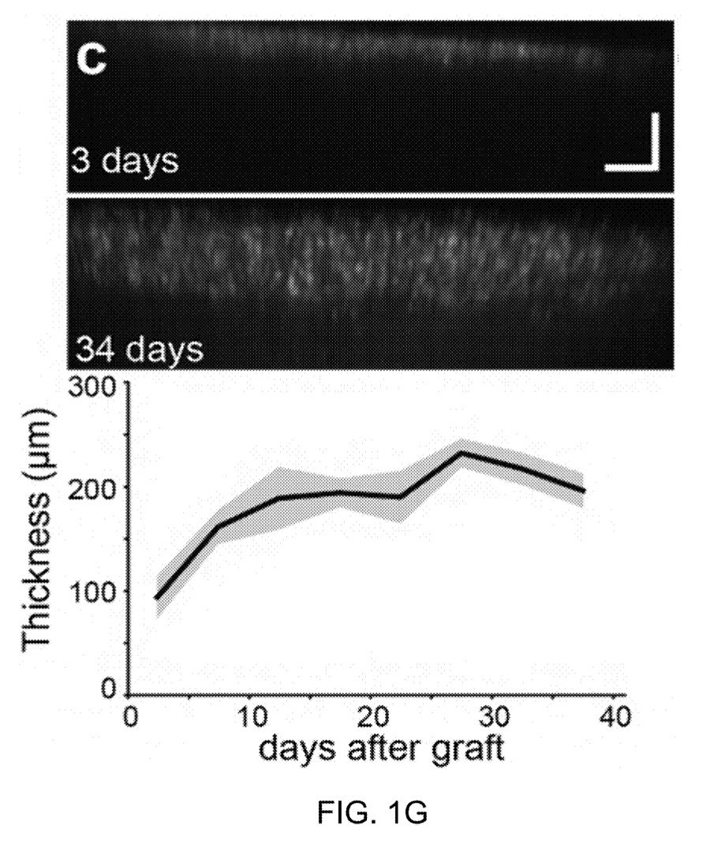

Microscopic Imaging of Neuron Growth and Activity
Thickness of L0 Increases over Time after Engraftment!
Example XZ projections of L0
L0 Thickness vs Time graph
Events from n = 11 mice

Slide 13
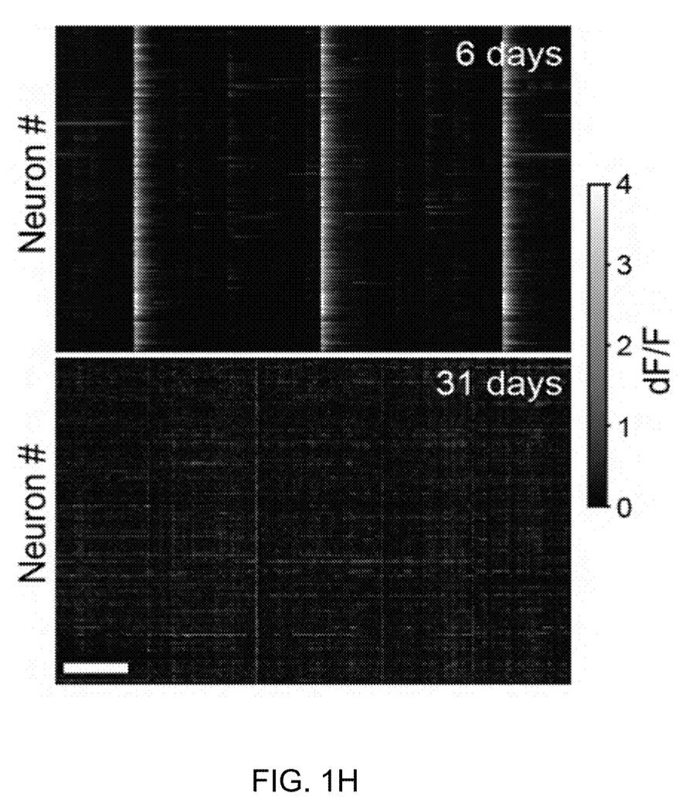





Calcium Imaging
1. Objective: Characterize changes in spontaneous activity of the engrafted layer (LO) through functional calcium imaging
2. Observations:
- Initial large, infrequent population events were seen around one week after engraftment
- By 2 weeks, population events became more frequent but less synchronous, with localized spatial clustering
- By 4 weeks, spontaneous activity resembled typical cortical activity, with generally asynchronous calcium signals and no apparent spatial structure
Representative Raster Plots of Spontaneous Activity – 6 & 31 Days after Engraftment

Slide 14
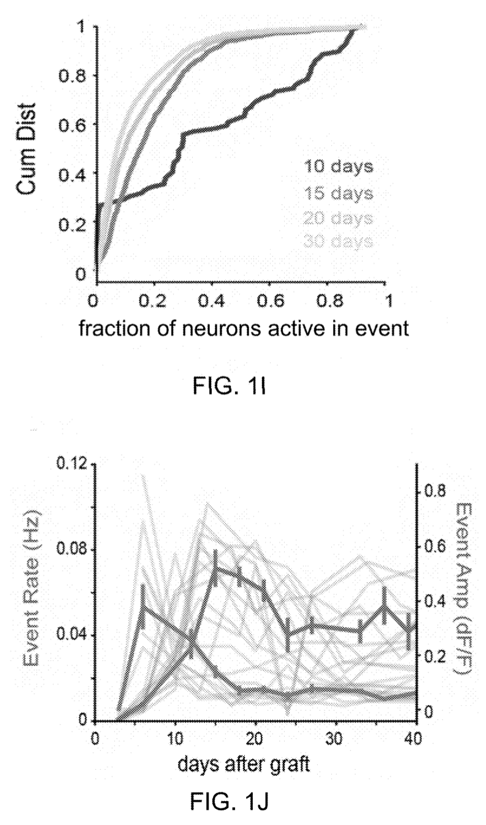
Calcium Imaging
Cumulative Distribution of Fraction of Neurons Active in Each Population Event
(from n = 11 mice)
3. Quantification:
- Early population events (first 10 days) involved a large fraction of cells (30-31% active per event) and significantly decreased after 10 days (7-15% active per event)
- Initially, individual neurons participated in most population events (66% of events), which reduced significantly after 10 days (27-34% of events)
- A transition from large, infrequent events to small, rapid events occurred 12-14 days after engraftment, similar to changes in the visual cortex after sensory experience onset
L0 Event Rate vs Event Amplitude over Time

Slide 15
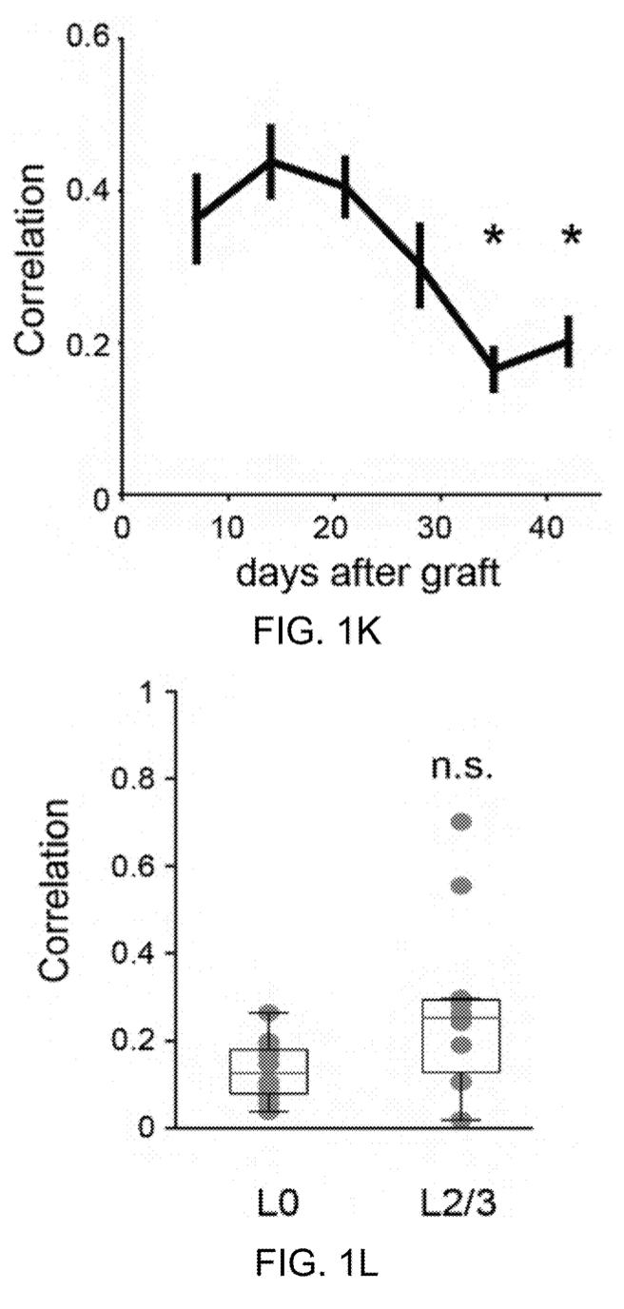

Calcium Imaging
Boxplot of Mean Pairwise Correlation of L0 & L2/3 Before First Behavioral Training Session (p=0.053, 2-sided t-test)
4. Correlation:
- Significant decrease in mean pairwise correlation of L0 neurons by one month (p=0.0013)
- Mean pairwise correlation of mature grafts was similar to or slightly below that of spontaneous activity in L2 (p=0.053)
Mean Pairwise Correlation of L0 Neurons over Time
P < 0.05, Kruskal-Willis Test with Dunn’s post-hoc test
n = 11 mice, electroporated GCaMP7s
n = 9 mice, viral GCaMP6s,

Slide 16
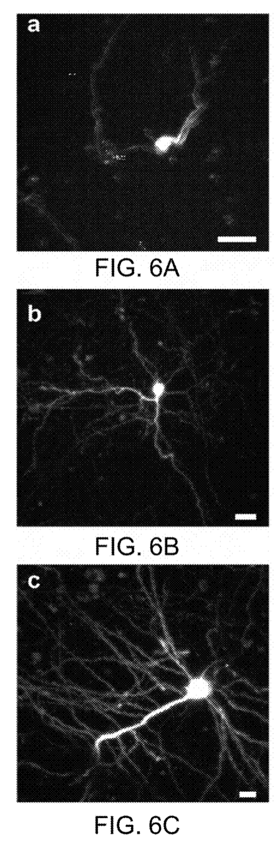
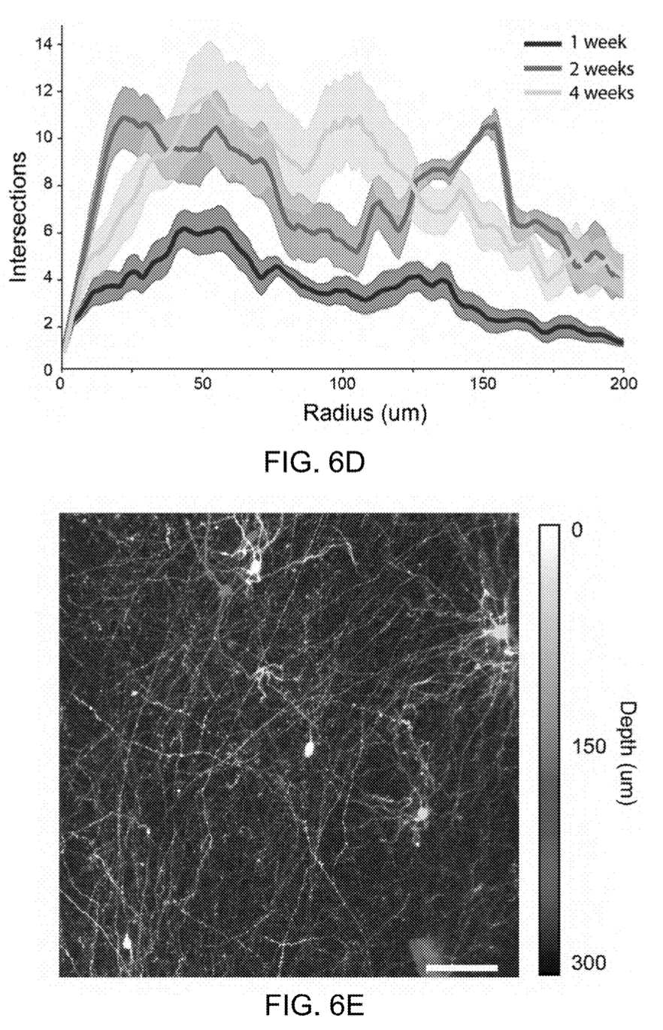
BMI Morphology
Sholl analysis of traced dendritic arbors from engrafted neurons
1. Objective: Assess the morphology of engrafted L0 neurons during development
2. Method:
- Sparsely labeled neurons with mRuby3 to visualize neurites using 2P imaging
3. Observations:
- Neurons began extending processes 3 days after engraftment
- Sholl analysis - increasing complexity of dendritic and axonal arbors, which stabilized by two weeks, preceding the maturation of firing patterns
4. Conclusion:
- Engrafted L0 neurons survived transplantation, extended neuronal arbors, and underwent developmental changes from synchronous waves to decorrelated activity resembling endogenous cortical activity
Maximal intensity projections of example neurons labeled with mRuby3
Depth-coded maximal intensity projection of a zoomed-out field of view from a mouse 4 weeks after engraftment.

Slide 17
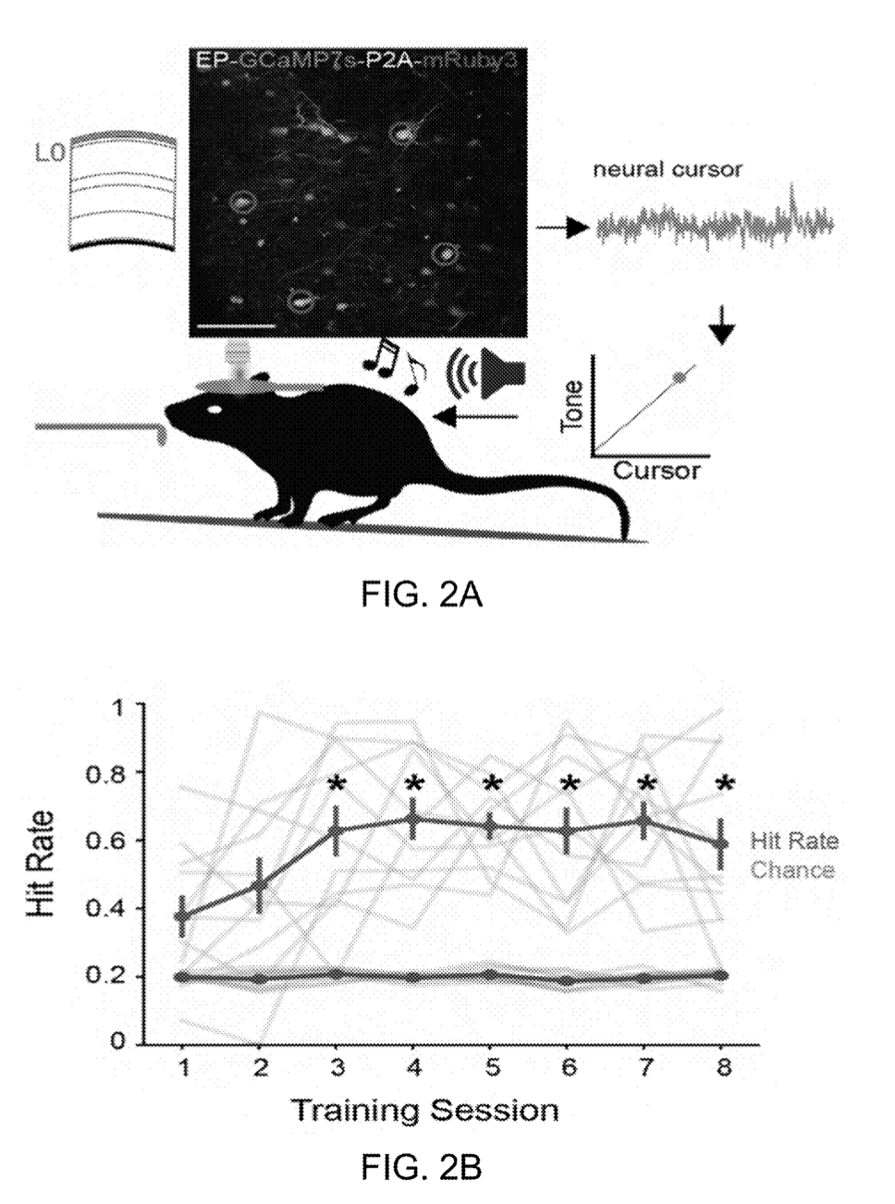
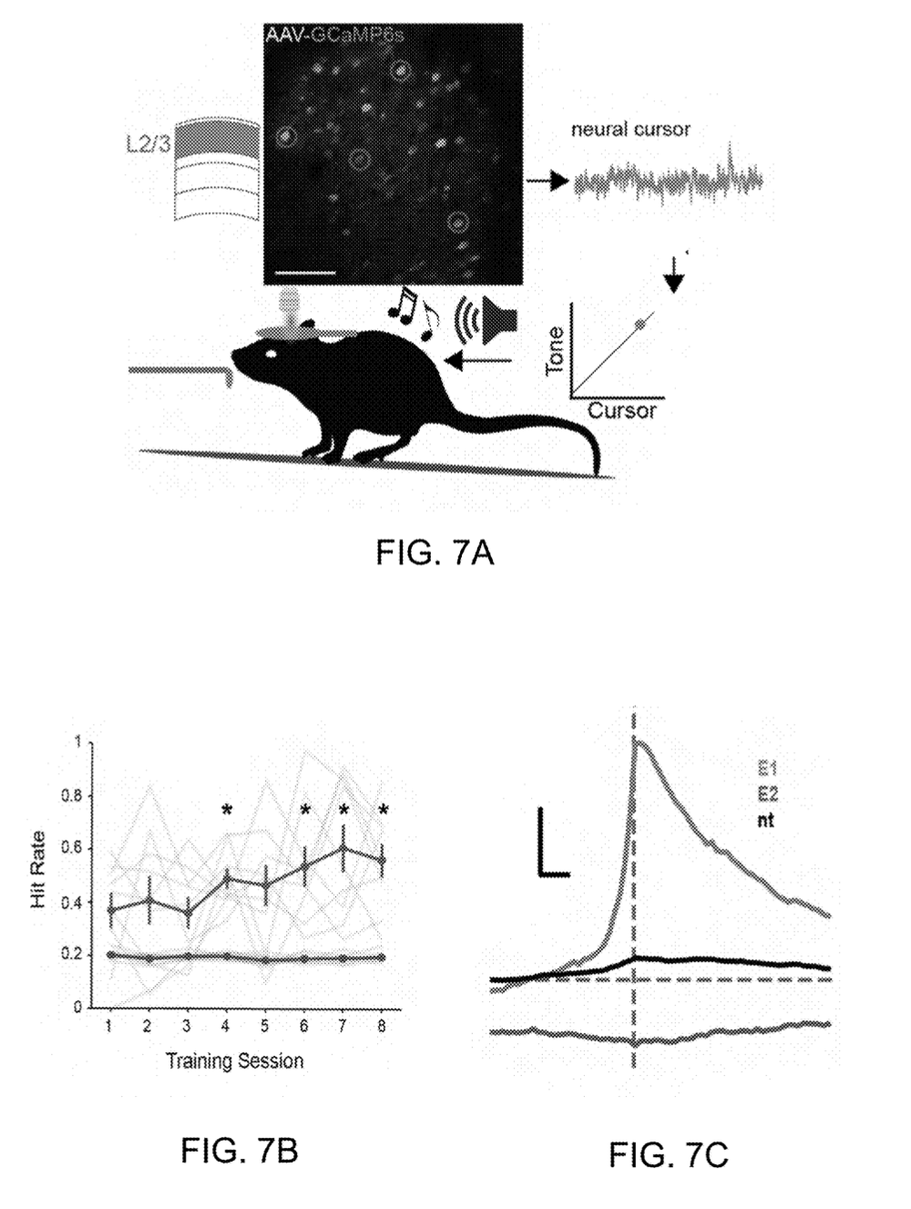
BCI Integration, Function, and Sensitivity
Engrafted (L0) mice
Control (L2) mice
1. Objective: Evaluate the integration, function, and sensitivity of the grafted L0 neurons in the host cortex for BCI applications
2. Structural Integration:
- Neurites extended from the cell body, suggesting functional integration
- L0-engrafted mice – trained to use the engrafted cortical layer for a BCI task showed successful modulation of neural activity for rewards
- Control (wild-type) mice – no engraftment, virally expresses GCaMP6
Optical BCI task:
Calcium signals from L0 are transformed into a neural cursor - tone played back to the animal
Water reward is administered when the cursor hits a threshold level within 30 seconds (“hit” trial)
Magenta circles – E1 ensemble neurons (go)
Green circles - E2 ensemble neurons (no-go)

Slide 18
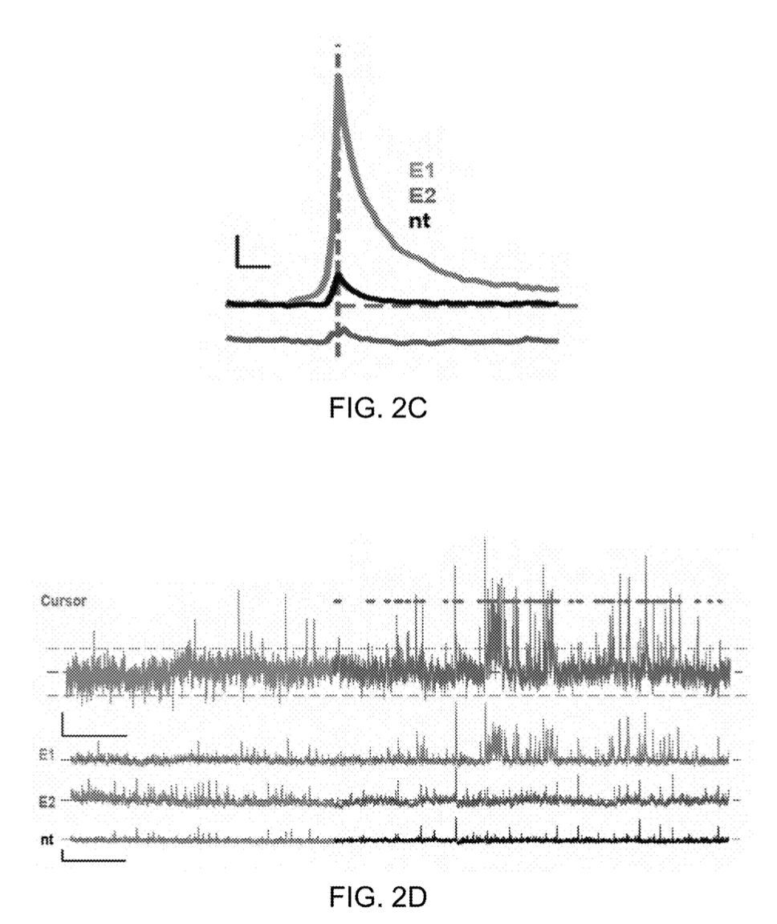
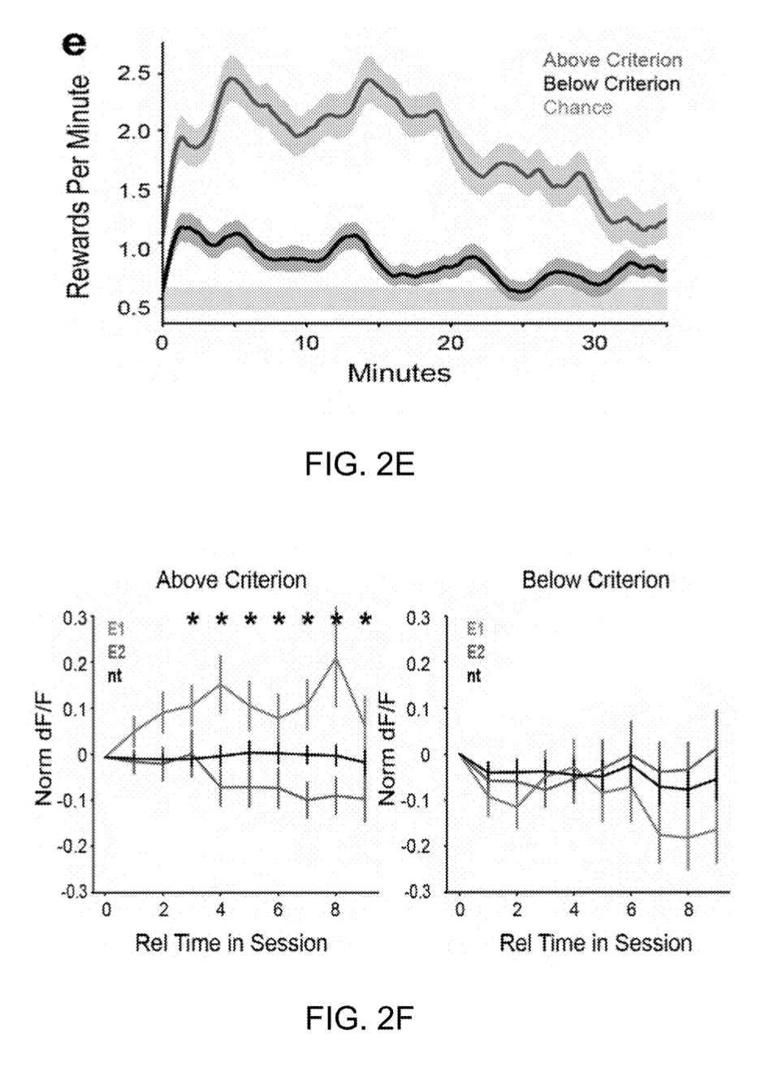
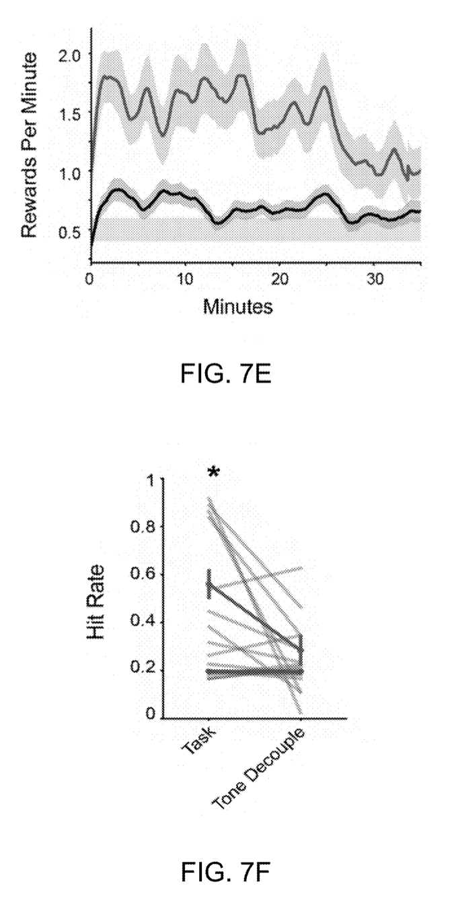
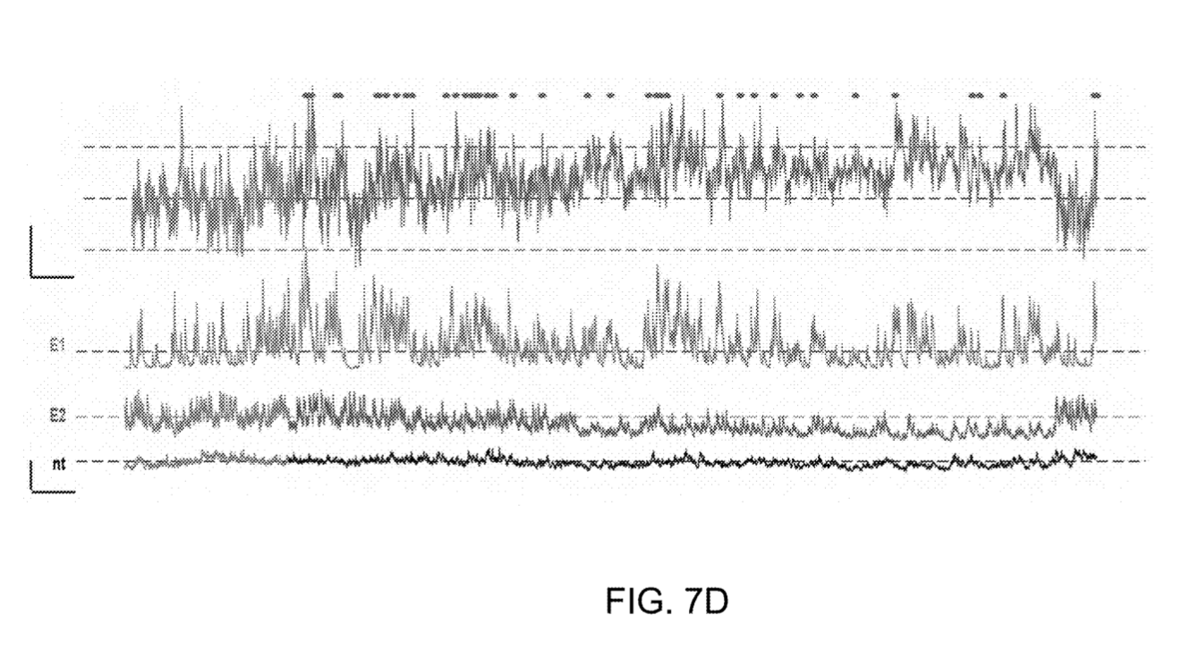




BCI Integration, Function, and Sensitivity
Engrafted (L0) mice
Control (L2) mice
3. Functional Testing:
- Control experiments with wild-type (L2) mice validated the calcium-imaging BCI task
- L2 mice – performed above 50% by the fourth day of training
- Engrafted (L0) mice – performed above 50% by the third day and maintained performance
- Reward-triggered average showed peak E1 activity and suppression of E2
- Rapid learning of the association between neural activity and cursor value mapping was essential for success for both L0 & L2 mice
Engrafted (L0) mice
Control (L2) mice

Slide 19
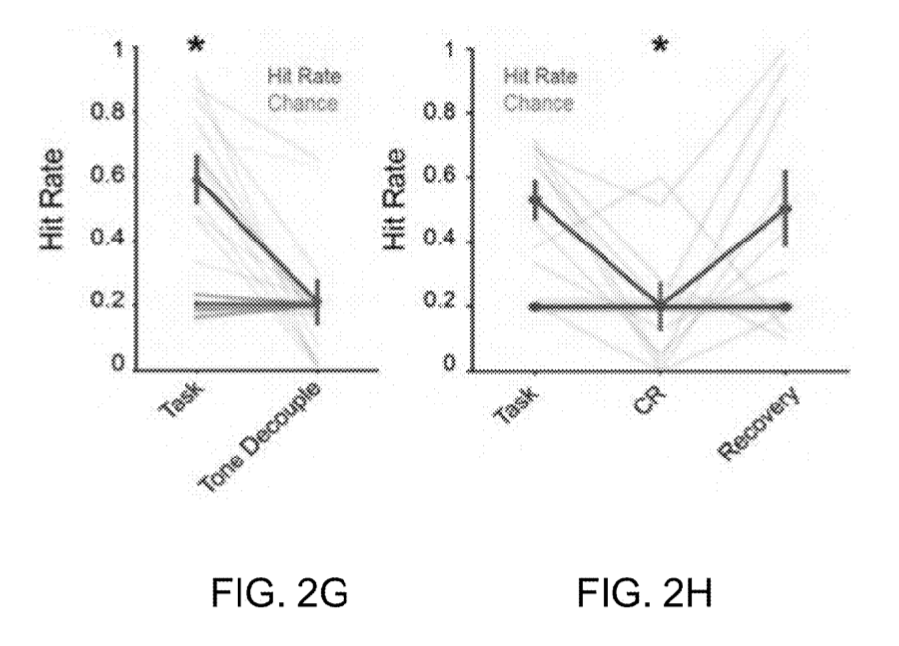


BCI Integration, Function, and Sensitivity
4. Sensitivity to Reward Contingency:
- Auditory feedback was crucial for task performance; decoupling it reduced performance to chance levels (around 50%)
- Reversing reward contingency mid-session showed that L0 neurons were sensitive to reward changes (recovery of hit rate)
Engrafted (L0) mice
Control (L2) mice
Tone Decouple – auditory tone no longer contains information of neural cursor
Contingency reverse (CR) – lowest (instead of highest) possible cursor value triggers reward

Slide 20
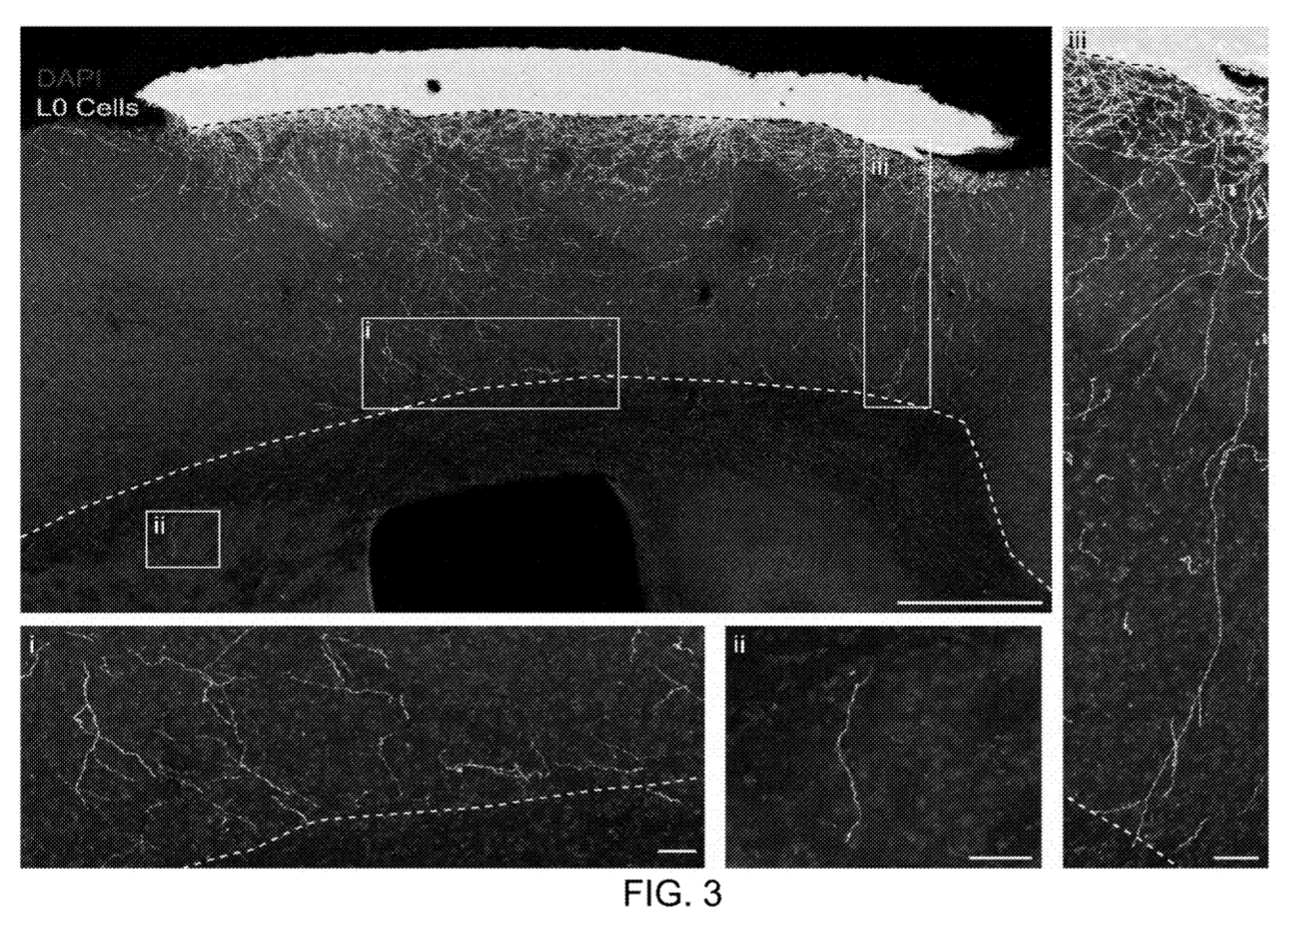
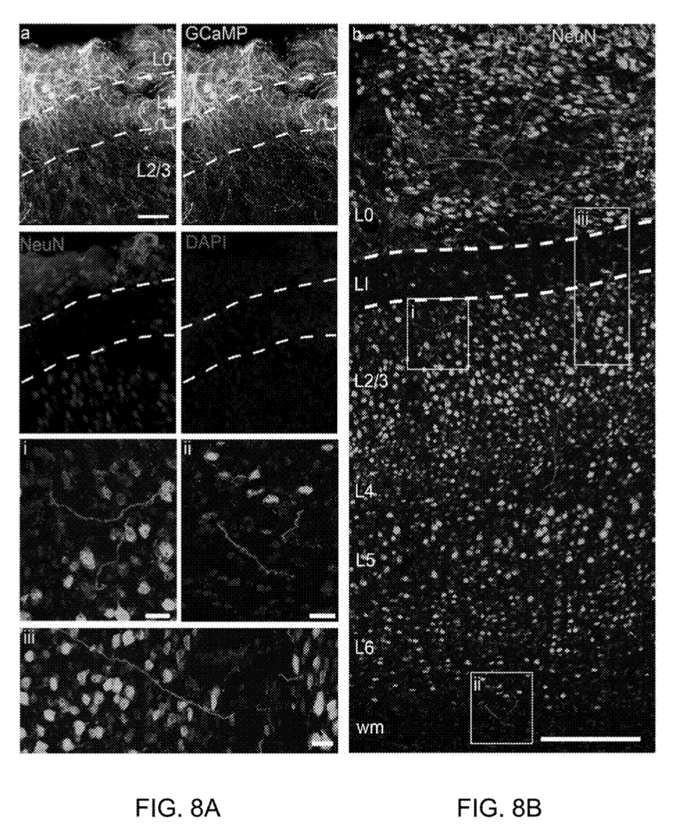
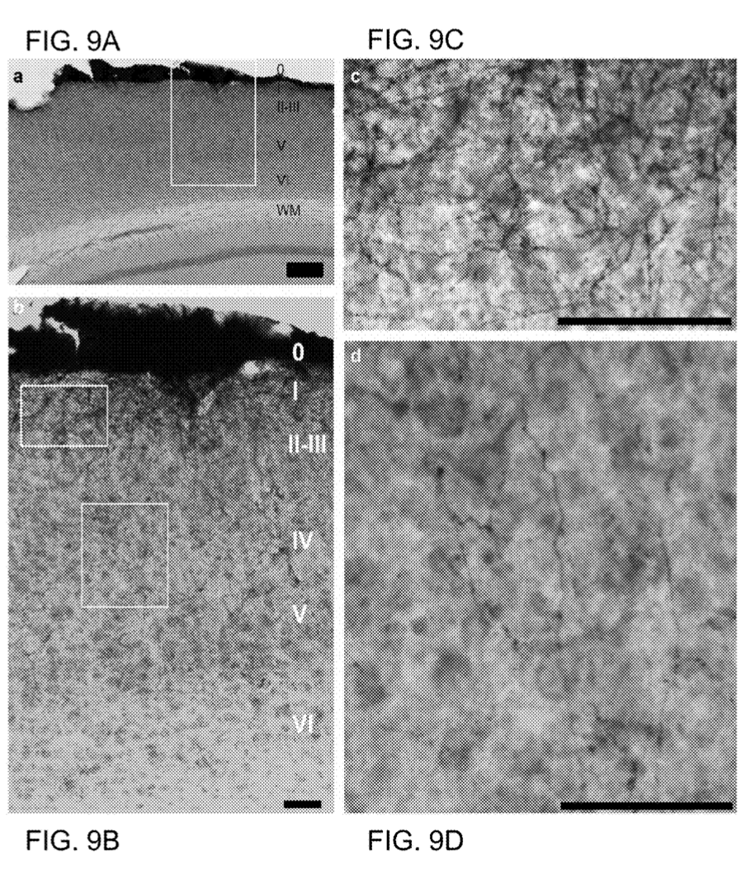

Histological Analysis of BCI
1. L0 Neuron Distribution:
- L0 neurons form a 50-500 μm band above L1
2. Projection of L0 Neurons:
- Dense lateral and downward processes from L0 neurons extend into the brain (FIGS. 3, 5A-5C, 8A, 8B, 9A-9C)
- Dendrites extend from L0 into L1 and the top of L2
- Axons infiltrate the entire cortical volume beneath the L0 graft and project to subcortical structures

Slide 21
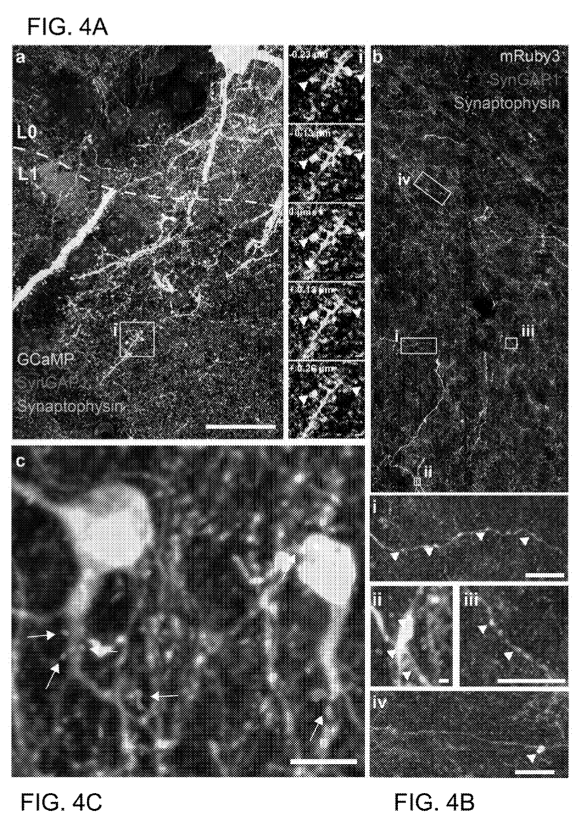
Histological Analysis of BCI
3. Histological Findings:
- High-resolution confocal imaging confirmed mature spines on L0 dendrites in L1
- SynGAP1 postsynaptic marker and synaptophysin presynaptic marker colocalized, indicating excitatory synaptic input in superficial layers
- Axons from L0 feature numerous putative boutons, suggesting neurotransmitter release onto host neurons
4. Integration and Synaptic Connections:
- Synaptophysin staining of L0 axons deep in the cortex shows proximity to SynGAP1 puncta (FIGS. 4A-4C)
- GAD65 staining indicated apparent GABAergic input on L0 neuron soma and proximal dendrites (FIGS. 4A-4C)
5. Conclusion:
- The data demonstrate extensive integration between the L0 graft and the host cortex, supporting the graft's ability to modulate neural activity for BCI tasks

Slide 22
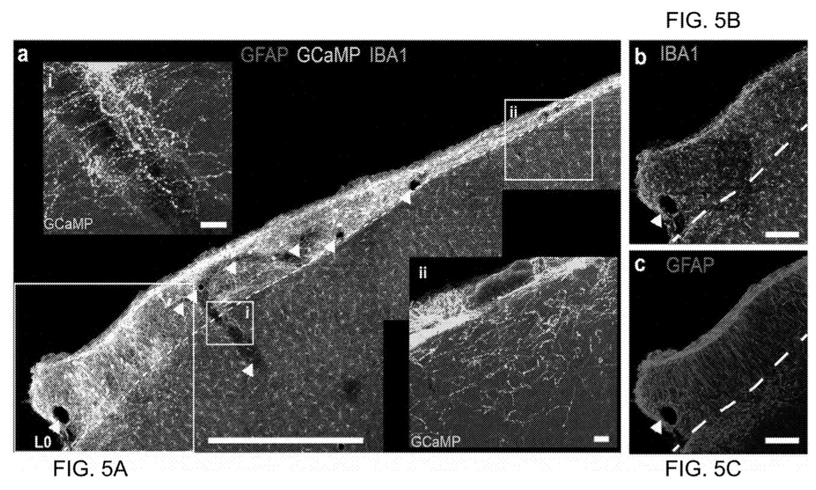
Glial Response to BCI
1. Objective: Evaluate the glial response to the grafted L0 neurons
2. Immune Response:
- Generalized immune response not anticipated due to the shared genetic background of graft and host cells
- Astrocytes and microglia were present throughout L0 without activated or phagocytotic morphologies, indicating no immune rejection or extensive glial scarring
3. Glial Presence and Function:
- Astrocytes and microglia in L0 did not colocalize with electroporated graft cells, suggesting these glia originated from the brain
- Elevated GFAP expression and lack of activated morphology suggest a proliferative state, likely providing metabolic and structural support
4. Tissue Remodeling:
- Astrocytes appeared to seal the space between the glass cranial window and the graft and to engulf blood vessels, indicating active tissue remodeling without neurotoxicity
5. Conclusion:
- Grafting an artificial cortical layer above L1 did not provoke a foreign body response or immune reaction
- Extensive infiltration of the brain by axons and dendrites formed and received synaptic connections, enabling bidirectional interfacing with the brain.

Slide 23
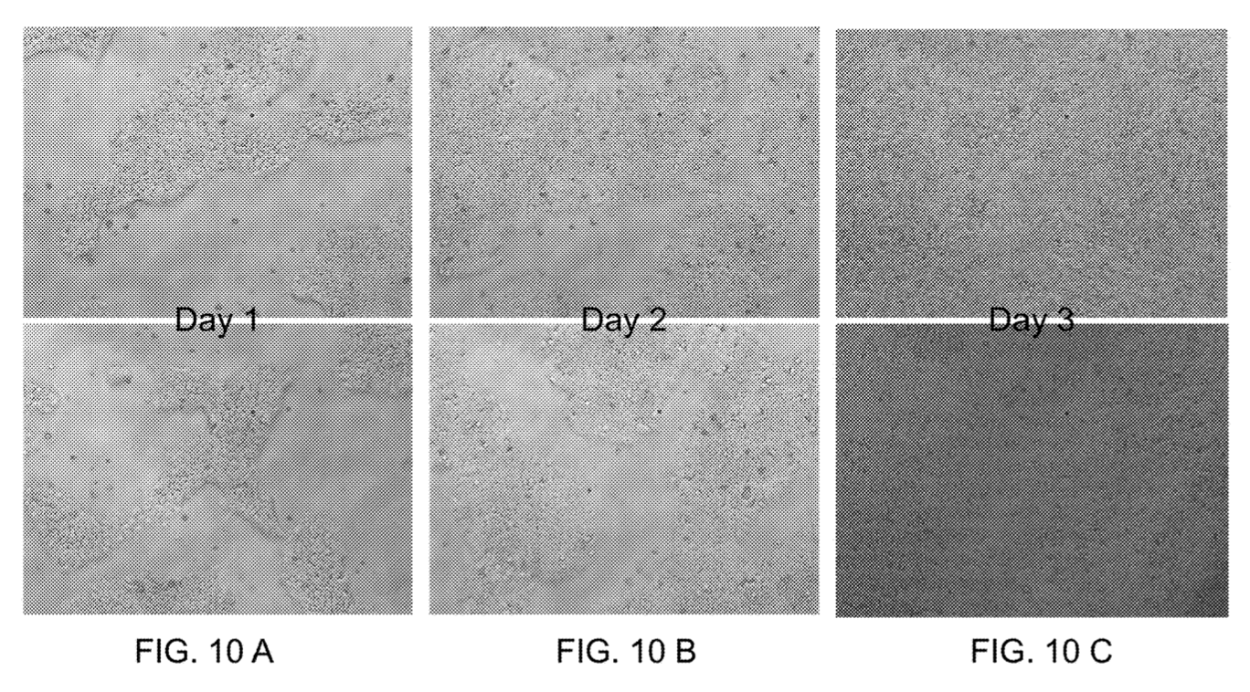
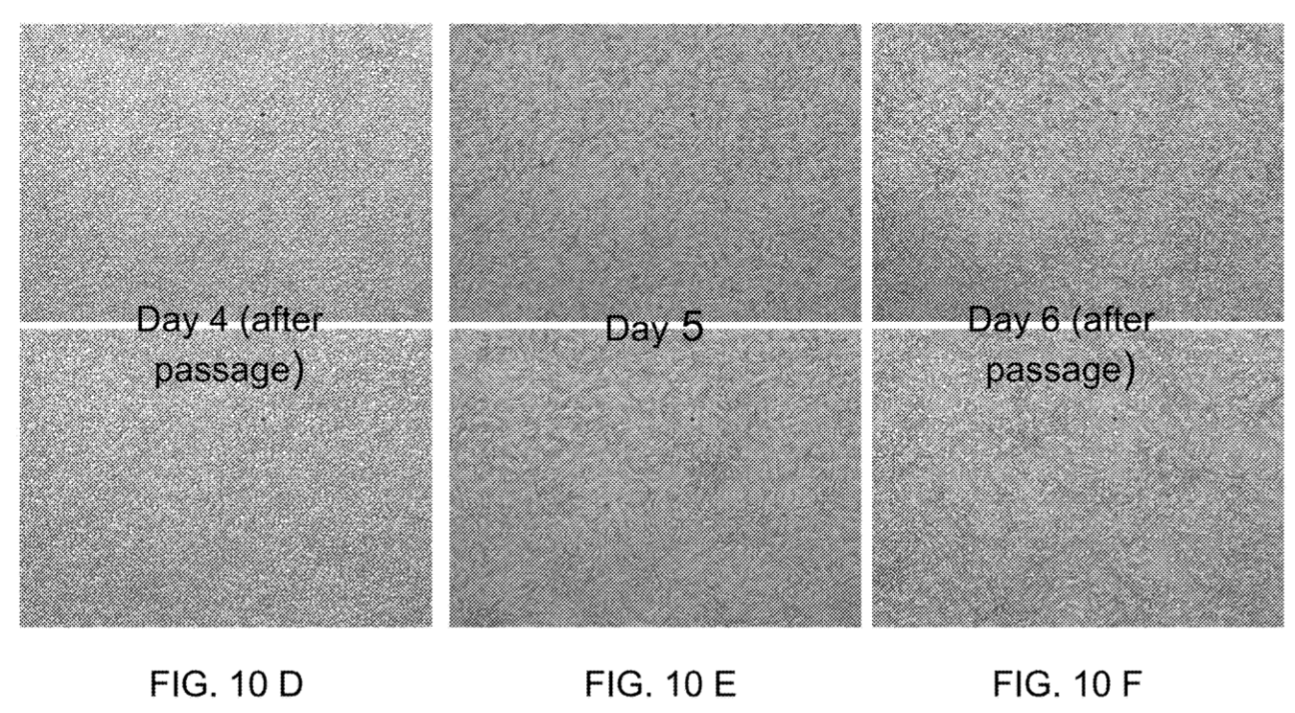
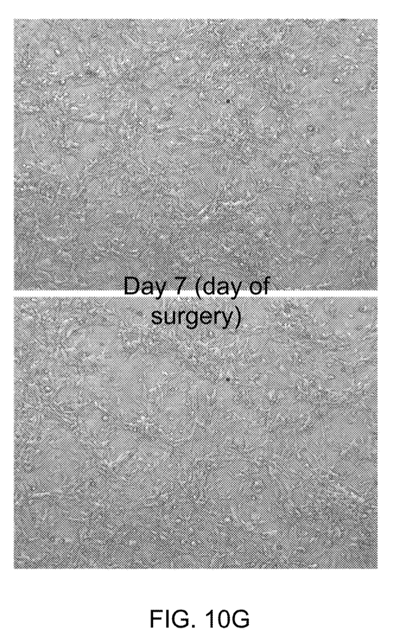
Human Stem Cell-Derived Neurons
1. Experimental Design:
- Two cohorts of mice: one immunocompromised with daily IP injections of cyclosporine (35 mg/kg), one naïve
- Surgeries - performed under sterile conditions in a biological safety cabinet
2. Plasmids and Human Neurons:
- Plasmids used: pCAG-H2B-mRuby3-P2A-GCaMP7s; PCAG-ChR2(H134R)-tdTomato; Cag-mRuby3; and pCAG-ChrimsonR-tdTomato.
- Human neurons - obtained using a modified protocol from Nehme et al., 2018, with iP11N stem cells from ALSTEM, genetically modified to harbor a doxycycline-inducible NGN2 cassette for rapid neuralization
3. Cell Preparation and Differentiation:
- Unlike Nehme et al.'s use of lentiviral insertion and puromycin selection, this study used EdU (an anti-mitotic) and passaged cells on Day 3 and Day 5 due to excessive progenitor proliferation
- Stem cell to neuron differentiation was tracked from Day 1 to Day 7 (right)
4. Post-Surgery Procedures:
- Behavioral testing was conducted on mice, followed by transcardial perfusion with formalin and brain excision for immunohistochemistry
5. Immune Response:
- Neuron differentiation led to a massive immune response, with activation of astrocytes (GFAP) and microglia (Iba1) around the implant site.
- The results indicate that immunocompromisation is necessary for successful grafting of human cells onto the mouse cortex.

Slide 24
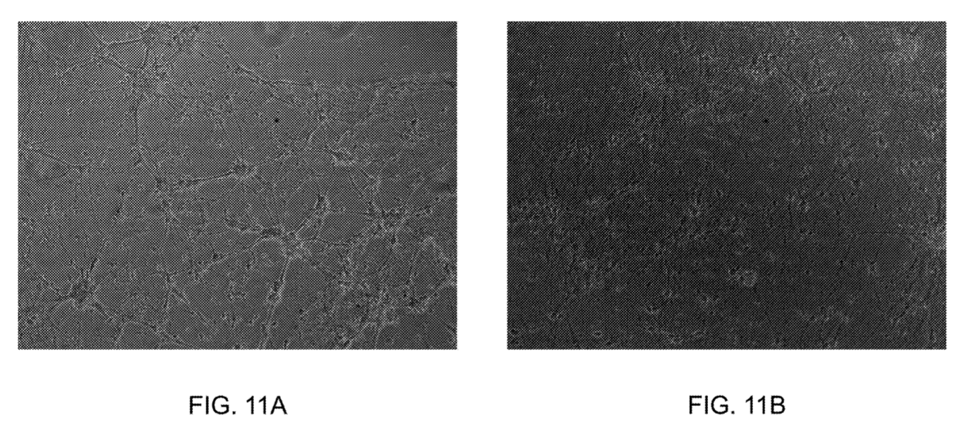
Cell-Tethering - Impact of In-Vitro Model on Neural Health
1. Development of In Vitro Model:
- Goal: Use the in-vitro model to test the efficacy of standard coatings on neural health
- Neuronal growth on an indium tin oxide (ITO) substrate is observed in the presence of poly-D-lysine (PDL) and laminin (LAM)
2. Neurospheres and Neural Progenitor Cells (NPCs):
- Neurospheres - aggregates of NPCs cultivated with growth factors
- Without growth factors and seeded on 2D PDL/LAM-coated surfaces, NPC neurospheres migrate and differentiate into neurons, astrocytes, and oligodendrocytes, forming complex networks
3. Coating Efficacy:
- Hydrogel adheres readily to PDL/LAM-coated surfaces, supporting neural growth and differentiation
Neuronal Growth on Indium Tin Oxide (ITO) Substrate with poly-D-lysine & Laminin

